Slide 1
Async Await Promises and Callbacks in JavaScript
KOSS Selection Task Round

Slide 2
Origin of asynchronicity
Computation done by processor- however more often than not, processor requests data from other sources (like a server)
Fetching data can sometimes take time
In the meantime processor sits idle- time getting wasted!
Scheduling tasks at time- actually saves time
Flexibility to leave main flow- much needed

Slide 3
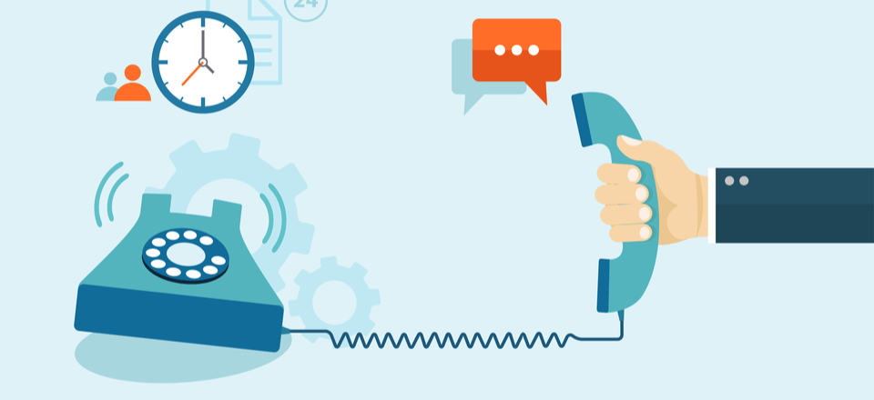
Callbacks v/s Normal functions
A callback is a function passed as an argument to another function
Most of the cases, they are triggered by some sort of event
Callbacks allow you to handle requests through nested functions
Callbacks- well they are used almost everywhere
"I will call back later!“ -Anonymous callback function

Slide 4
Making callback function calls
console.log("registering click handler");
button.addEventListener('click', () => {
console.log("get click");
});
console.log("all done");
// Will log first and third statements but will wait for button click event for second
The second log statement waits and won’t get invoked until the ‘click’ event is pending
Let's say you call your friend and ask him for some information:
(Synchronous) You stay on the phone with him and wait while he is looking for information.
(Asynchronous) You tell your friend to call you back once he has the information. Meanwhile, you can focus all of your attention on the other tasks

Slide 5
Blocked code- why asynchronous needed
Programming is traditionally single thread- can do tasks in a single run
Synchronously- code executes in the same sequence as it is written in the script
Much work in web development- fetching data from servers
Some tasks heavy and some light, putting them in single order ‘blocks’ our flow- execution waits for the heavy task to finish and then proceeds with the light ones
Methods to solve this problem- timeouts, promises, await – async syntax
A word of caution- asynchronous code executes code in a different sequence hence may change state of program in between
Asynchronous a bit difficult to maintain as compared to synchronous.

Slide 6
Timeouts- simple asynchronous code
A classic example of asynchronous callback functions
setTimeout() does not pause the execution but rather schedules something in future
Hence we come back to log second after we’ve finished 2 seconds, but in the meantime “Hello again!” is logged (rest of the program goes in flow)
// Say "Hello."
console.log("Hello.");
// Say "Goodbye" two seconds from now.
setTimeout(function() {
console.log("Goodbye!");
}, 2000);
// Say "Hello again!"
console.log("Hello again!");

Slide 7
Do we need a better solution than callbacks?
Creatively using callbacks to sort
Callback hell (Pyramid of callbacks)
let arr = [10, 100, 500, 20, 35];
arr.forEach(item => {
setTimeout(() =>
console.log(item), item);
});
// 10 20 35 100 500
chooseToppings(function(toppings) {
placeOrder(toppings, function(order) {
collectOrder(order, function(pizza) {
eatPizza(pizza);
}, failureCallback);
}, failureCallback);
}, failureCallback);

Slide 8
Promises- Elegant solution to callbacks
The previous asynchronous code when written using promises will look something like this-
Similar to callbacks, a promise represents the eventual completion / failure of an asynchronous task
Make the overall code simple to read by chaining subsequent promises using .then() and .catch() method (for completion and rejection respectively)
chooseToppings()
.then(toppings => placeOrder(toppings))
.then(order => collectOrder(order))
.then(pizza => eatPizza(pizza))
.catch(failureCallback);

Slide 9
Promise- in layman terms (a convo)
A: can you get me item1 from the market?
B: Sure
A: While you do that, I’ll check for item2 in my room (asynchronous code, main stack being run) but do let me know if you have item1 (promise return)
B: What if I don’t find you when I come back?
A: In that case, drop me a message and tell me the status (success or failure callback)
B: Sounds good! Let’s do it then

Slide 10
Creating a promise
let done = true;
const isItDoneYet = new Promise((resolve, reject) => {
if (done) {
const workDone = 'Here is the thing I built’;
resolve(workDone);
} else {
const why = 'Still working on something else’;
reject(why);
}
})
A promise can be compared to a proxy for a value that will eventually becomes available
Once a promise has been called, it will start in a pending state. This means that the calling function continues executing, while the promise is pending until it resolves, giving the calling function whatever data was being requested.
The created promise will eventually end in a resolved state, or in a rejected state, calling the respective callback functions (passed to then and catch) upon finishing.
Hence a substitute to callback

Slide 11
Consuming a promise
The .then() keeps track of successful promises and the .catch() methods track rejected ones- analogous to try and catch from the sync version
We can even have an array of promises executed using Promises.all() (execute something when they are all resolved.)
Battery API, Fetch API, Service Workers are modern web API which use promises
const isItDoneYet = new Promise(/* ... Prev slide ... */) const checkIfItsDone = () => {
isItDoneYet
.then(ok => {
console.log(ok)
})
.catch(err => {
console.error(err)
})
}

Slide 12
Time for a quick JS moment
How will you write a simple sleep function using promises and setTimeout()?
One possible solution-
function sleep(ms) {
return new Promise(res => {
setTimeout(res, ms);
});
}

Slide 13

Promises- A summary
Has four states (fulfilled, rejected, pending, settled)
Events added with .then() will never be invoked before the completion of the current run of the JavaScript event loop
Multiple callbacks may be added by calling .then() several times. They will be invoked one after another, in the order in which they were inserted
Code readability improves

Slide 14
One step ahead- Async and Await
async keyword- converts a function into its async version which knows how to handle asynchronous code invoked using await keyword
async function always returns a typecasted promise
await only works inside async functions (can also be used on its own with JavaScript modules)
await can be put in front of any async promise-based function to pause your code on that line until the promise fulfills. An example-
async function hello() {
return greeting = await Promise.resolve("Hello");
};
hello().then(alert);

Slide 15
Real- life example: connect better
Imagine your daily routine has five tasks- shower, breakfast, dressup, read news
You can do them sequentially or do them in any order and complete as fast as possible
But some constraints- you cannot dressup before shower
So, to maintain some order, we use await keyword to wait for a promise to be resolved before continuing to the next task
Hence dealing with similar large asynchronous tasks becomes easier to work with

Slide 16
Essence of async and await
async and await are only for wrapping around promises in a sugary syntax
Real computation- Promises
Makes the original variable based promises easier to work with
Now can handle wait requests inside functions- ease in work flow
Same asynchronous code modularized using async
This only affects the order of promises within a specific async function

Slide 17
Understanding through an example
Can you figure out the output for this snippet?
Thinking about the flow of code in terms of main stack and await stack will help here
Let’s break it down and understand it better-
num = 0 → await encountered, set aside and continue main stack → num += 1 makes it 1 → log 1 → go back to await, return 2 → num += 2 but here num is 0 (async code) → log 2. 1 2
let num = 0;
async function increment() {
//Promise.resolve(2)
num += await 2;
console.log(num);
}
increment();
num += 1;
console.log(num);

Slide 18
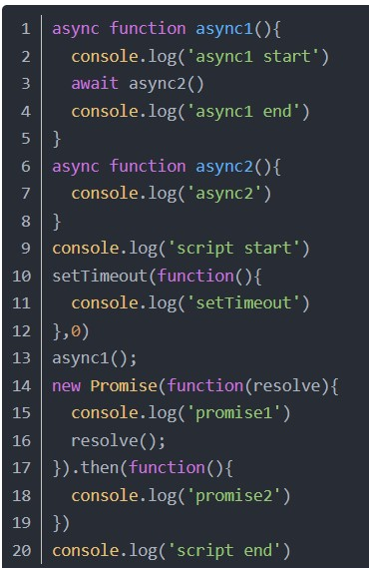
Bonus Question!
Find ye output mates

Slide 19
THANK YOU!
“Who can wait quietly while the mud settles?
Who can remain still until the moment of action? ”
-Laozi, Tao Te Ching
Remember to keep your asynchronous threads sorted :-)

